Slide 1
Dealing with missing values , Data Transformation and Splits

Slide 2
Dealing with missing values
Let’s create a dataframe
x <- c(“1”, “5” , “12”)
y <- c(1, 11, NA)
z <- c(“1”, “12” , “?”)
data <- data.frame(x, y, z)
1. Finding the mean of column x :
> mean(data$x)
[1] NA
Warning message:
In mean.default(data$x) : argument is not numeric or logical: returning NA

Slide 3
Dealing with missing values
We need to convert the values in column x to numerals
data$x <- as.numeric(as.character(data$x))
> mean(data$x)
[1] 6
Whenever you convert the values of a column from string to numerals , always use as.numeric(as.character()) instead of as.numeric() because by default a character vector in a dataframe becomes a column of factors . So you need to convert it to character type first.

Slide 4
Dealing with missing values
2. Calculating the mean of column y : The elements are already numerals . So no need to use as.numeric() function
> mean(data$y)
[1] NA
To ignore the rows in which column y has the value ‘NA’
> mean(data$y, na.rm = TRUE)
[1] 6
> max(data$y, na.rm = TRUE)
[1] 11

Slide 5
Dealing with missing values
3. Finding the mean of column z : Since this column has string values , need to convert them to numerals first.
data$z <- as.numeric(as.character(data$z))
> data$z
[1] 1 12 NA
Since the element “?” cannot be converted to a numeral , it was replaced by NA in the data frame. Now we can calculate the mean as before
> mean(data$z, na.rm = TRUE)
[1] 6.5

Slide 6
Data Transformation and Splits : Objectives
To understand how data frames can be transformed by mapping a column onto itself or mapping several columns onto a new column.
Transformations are important because
A transformed scale can be more convenient at times(e.g. percentages rather than original data or cosine rather than degrees) .
Complexity of algorithms can be decreased by analysing a single mapped column rather than multiple columns .

Slide 7
Transform
Import the wine dataset and change the data frame name
wine <- X541WINE
2. Add a new column ‘RATE_PRICE’ which is the ratio of the
columns RATE and PRICE
wine <- transform(wine, RATE_PRICE = RATE / PRICE)
3. The new column ‘RATE_PRICE’ should be seen in the output of
colnames(wine)
4. Compare the mean values of PRICE and RATE_PRICE for every
country

Slide 8
Transform
sort(tapply(wine$PRICE, wine$COUNTRY, mean) , decreasing = TRUE)
Australia France Italy California Argentina Montenegro Kazahstan
145.12171 138.02150 136.18953 131.90437 120.60300 73.56176 72.35150
sort(tapply(wine$RATE_PRICE, wine$COUNTRY, mean) , decreasing = TRUE)
Montenegro Italy Kazahstan Argentina California France Australia
4.6143540 1.1346423 1.1043752 0.6289900 0.5941662 0.5168803 0.5038631
We can see that the average price of Australian wines is the highest but the average price per rating is the lowest whereas it is the opposite for Montenegro - Interesting . We can conclude that similar quality wines are available at much cheaper rates at other countries when compared to Australia. This shows that we might get a better insight into the data by creating a new attribute.

Slide 9
Transform - Multiple new columns
Let’s add 2 new columns using the transform function , the normalized PH and the normalized ALCOHOL columns (normalized on a scale of 0 - 10)
We’ll use the following normalization formula for a column x
normal(x) = 10 * ( x - min(x) ) / (max(x) - min(x))
ph.range = max(wine$PH) - min(wine$PH)
alcohol.range = max(wine$ALCOHOL) - min(wine$ALCOHOL)
wine <- transform(wine, PH_NORMAL = 10*(PH - min(PH))/ph.range , ALCOHOL_NORMAL = 10*(ALCOHOL - min(ALCOHOL))/alcohol.range)

Slide 10
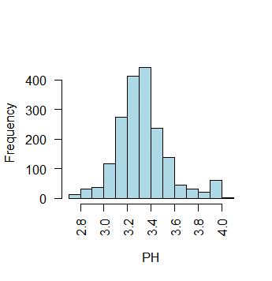
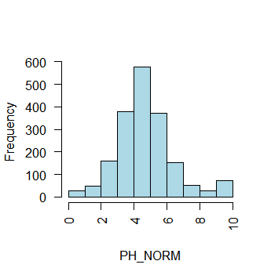
Transform - Multiple new columns
4. hist(wine$PH, xlab="PH", col = "lightblue" , las = 2 , main = " ")
5. hist(wine$PH_NORMAL, xlab="PH_NORM", col = "lightblue" , las = 2 , main = " ")
The distribution shape is the same for the PH and PH_NORMAL columns . Only the scale is different.

Slide 11
Dataframe Splits
Sometimes it’s necessary to split a dataframe into smaller dataframes and apply different transformations to each of the smaller dataframes.
E.g. For the automobile dataset , we will split the cars into two groups based on the fuel type and perform separate analysis on the two groups .
For the cars running on gas, we want to calculate the average horsepower per unit volume of the cars.
For the cars not running on gas, we want to calculate the average curb-weight for every unit of engine-size.

Slide 12
Dataframe Splits and Transformations
Cars running on gas
i. automobile.gas <- subset(automobile, automobile$`fuel-type` == "gas")
ii. Add the new column ‘volume’
automobile.gas <- transform(automobile.gas, volume = length*width*height)
iii. Calculate the horsepower per unit volume (horsepower is a string value)
automobile.gas <- transform(automobile.gas, hp_per_vol =
as.numeric(as.character(horsepower))/volume)
iv. Calculate the average horsepower per unit volume
mean(automobile.gas$`hp_per_vol`, na.rm = TRUE)
0.0001728467

Slide 13
Dataframe Splits and Transformations
2. Cars not running on gas
i. automobile.others <- subset(automobile, automobile$`fuel-type` != "gas")
ii. Add a new column for the ‘curb-weight per unit engine-size’
automobile.others <- transform(automobile.others,
cw_per_es = `curb-weight` / `engine-size`)
iii. Now we can calculate the mean
mean(automobile.others$`cw_per_es` , na.rm = TRUE)
21.58553

Slide 14
Thank You

